Slide 1





Predicting Voter Turnout
By Marzuq Khan

Slide 2
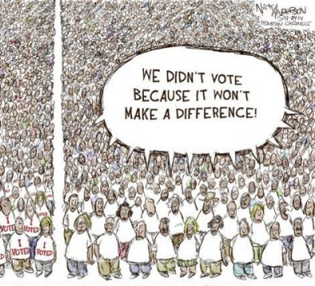
Main Points
There is predicted to only be about 13% of voter turnout for the 2014 General Election
According to logistic regression models only about 6,435 people out of about 50,000 will vote
Do not rely on this too heavily because vh14p as a predictor variable was probably incorrect

Slide 3

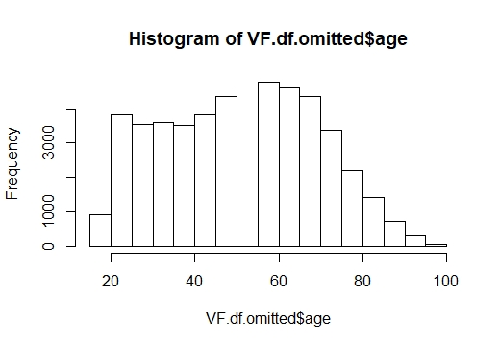
Histogram of Age
Logistic Regression showed Age to be a significant variable
This is just a basic histogram to understand the number of different ages that vote
The frequency of voters from about 20 to 60 stays about the same with a bit of an increase in this dataset
Almost seems to follow a normal distribution

Slide 4
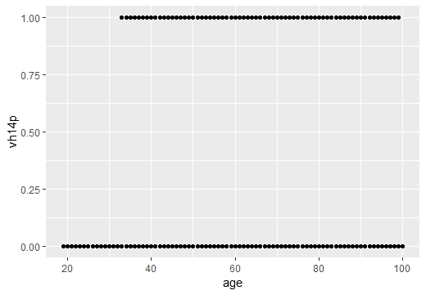
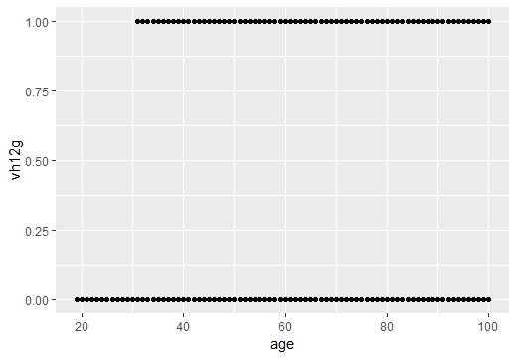
Scatterplots of Age
It seems as though no one from the ages of 18 to about 30 seemed to vote in either the 2014 primary elections or the 2012 general elections
There should be similar amounts of 20 to 30 year old as 30 to 40 year old according to the histogram on the previous slide
Getting younger people to vote could definitely impact elections

Slide 5
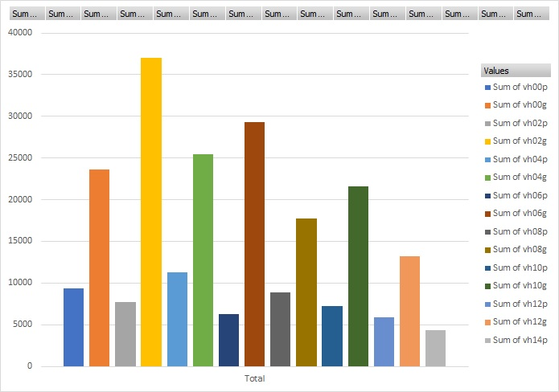
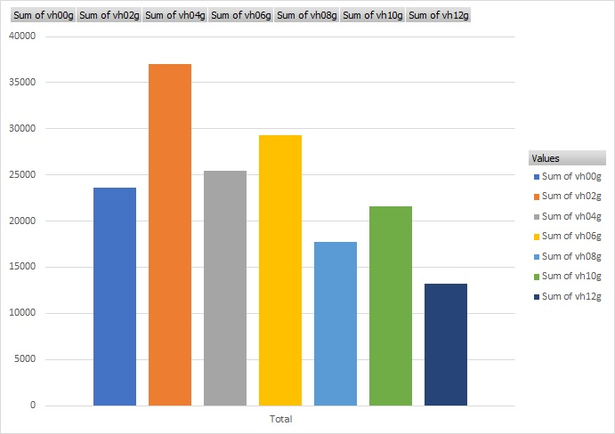
Voter Turnouts
When looking at voter turnout for all the listed elections, there are clearly less voters for primary elections (Top Chart)
If you only look at general elections there seems to be a decreasing trend (Bottom Chart)
What is weird is that presidential elections have less turnout after the past general election, but then turnout increases again for the following non-presidential general election (Bottom Chart)
Disregarding all other variables and estimating off of this trend voter turnout for the 2014 general election could be closer to 15,000 or about 30%

